Slide 1
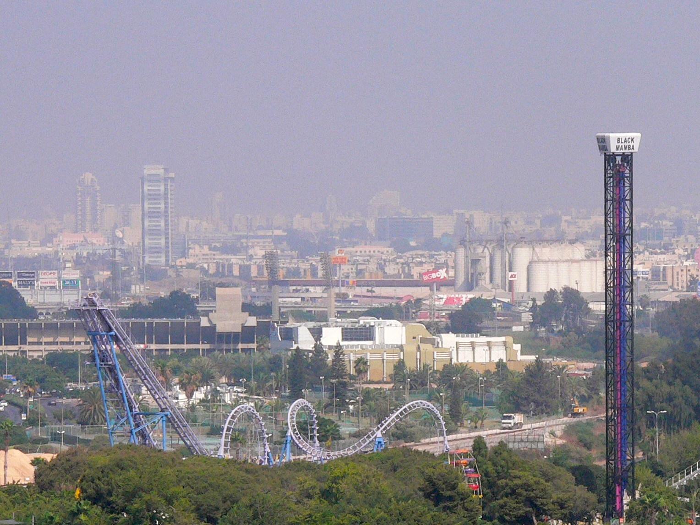
Practical Template-Algebraic Side Channel Attacks with Extremely Low Data Complexity
Yossi Oren, Ofir Weisse and Avishai Wool
HASP Workshop, Tel Aviv, July 2013
Notes:
Exciting work, share the excitement

Slide 2
Power Analysis Attacks
Given a description of a crypto device, plaintexts, ciphertexts and a set of power measurements, find the cryptographic key
Crypto Device
Plaintext
Ciphertext
Key
Power

Slide 3
Profiling Attacks
DUT
Reverse Eng.
Offline Traces
Online Traces
Power Model
Decoder
Secret Key
3
Notes:
Template attacks, but also PCA, MV, Stochastic, etc.

Slide 4
Profiling Attacks
Pro: Very versatile
Con: High data complexity
DUT
Offline Traces
Online Traces
Notes:
How do we reduce complexity?

Slide 5
Review: solvers and optimizers
Goal function
Set of m logical statements over n variables
x₁, …,x_{n}
Solver
Optimizer
Satisfying assignment
Optimal
Notes:
Optimizers are much slower than solvers
Generally: solvers are faster, optimizers are more versatile
Solvers are used a lot in the community as part of the design toolchain

Slide 6
Cryptanalysis using solvers
Modern crypto is strong enough to withstand Algebraic Cryptanalysis using solvers [MM00]
If we add side-channel information the key can be recovered quickly and efficiently [RS09]
Physical limitations of the attack setup introduce errors which can be overcome by replacing solvers with optimizers [OKPW10]
Decoding can be generically represented as a vector of aposteriori probabilities [ORSW12]
Oren, Kirschbaum, Popp and Wool,
CHES 2010
Massacci and Marraro, Journal of Automated Reasoning 2000
Renauld and Standaert, INSCRYPT 2009
Oren, Renauld, Standaert and Wool,
CHES 2012
Notes:
What’s missing: evaluation on real data traces

Slide 7
The Template-Algebraic
Side-Channel Attack (Template-TASCA)
Works for any profiled model
Combines the low data complexity of algebraic attacks and the versatility of template attacks
Our contribution: First practical evaluation on a public data set

Slide 8
Versatility of Template-TASCA
Template Decoder
Power Trace
Secret Key
Notes:
Typical template attacks look only at the key bytes
Related work:TU Darmstadt , host 2012
Mohamed Saied Emam Mohamed, Stanislav Bulygin, Michael Zohner, Annelie
Heuser, and Michael Walter. Improved Algebraic Side-Channel Attack on AES\

Slide 9
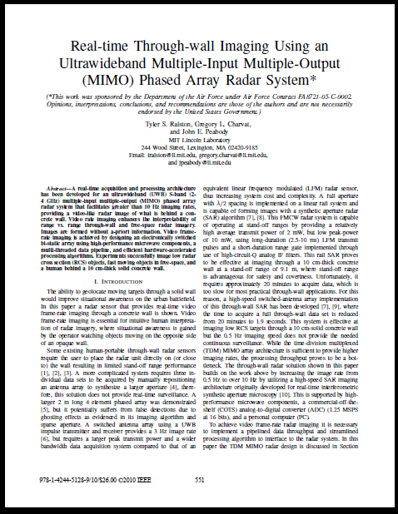
Versatility of Template-TASCA
Power Trace
EM Trace
Whatever
Template Decoder
Aposteriori probability vectors
Solver/ Optimizer
Secret Key
Hamming weights
Notes:
What’s significant – apos. Vectors are not of the key bytes but of intermediate steps
The decoder does not have to be very good!

Slide 10
Shopping list
Device under test (DUT)
Template decoder
Optimizer (or solver)
Cipher equations
Leak equations
Notes:
We can provide equation sets for Keeloq and uC AES

Slide 11
The IAIK WS2 Data Set
DUT:
  8-bit 8052-compatible μC
  Standard implementation of AES encryption
Trace set:
  200 traces of the first round of AES with known plaintext and unknown key
  Key is the same between all traces!
Can be attacked using classical CPA with n=50

Slide 12
Extracting data from the traces
Our goal: extract 84 “leaks” from each of the 200 traces corresponding to parts of the AES state
Main challenge: automatically finding regions of interest
Our approach: Greedy algorithm based on classical CPA

Slide 13
Start like template…
In offline phase, create template decoders for many intermediate states
In online phase, apply decoders to power trace, obtaining multiple aposteriori probability vectors
Notes:
Many many templates – they can be low quality

Slide 14
… end like TASCA
Pass probability vectors, together with device description, to optimizer or solver
The output will be the state (and key) which optimally matches the probabilities of all the intermediate values:
Notes:
In case of solver, use a heuristic instead

Slide 15
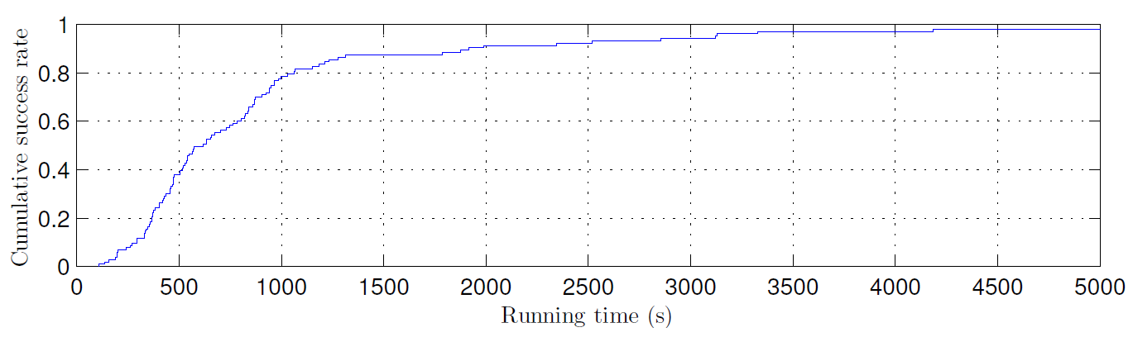
Results
2 online traces: 100% success rate, median running time 600 seconds
Single online trace: 77% success rate, median running time 25 hours
Full key was recovered, not just Hamming weights!

Slide 16
Future directions
Further reduce the data complexity of the offline phase
Combine TASCA with other profiling attacks (Stochastic approach, PCA, machine learning, multivariate regression etc.)
Apply Template-TASCA to additional public data sets (DPA Contest v2, etc)

Slide 17
Summary
Template-TASCA can be used to mount side-channel attacks with very low data complexity
Can be combined with any profiling attack and any leak
First evaluation of this (theoretically) very strong attack on a real world device
Notes:
, getting closer to practice
Future work: Investigate different decoders, leakage models (template based, Naïve Bayes, etc)
Establish limits for data/computation tradeoffs for successful key extraction
Hand-raising for AES equation set

Slide 18
Thank you!
http://iss.oy.ne.ro/Template-TASCA
Notes:
Video of 1-hour talk on the site, if you’re interested

Slide 19
The Information-Robustness Tradeoff

Slide 20

Measurement Space
Precise measurement
Actual measurement
Source: NASA / The Hubble Heritage Team / STScI / AURA
Notes:
Each axis is a different leak – we typ. Have hundreds
This is not the key – it’s the precise measurement

Slide 21
The Harsh Reality of Power Analysis
The side channel traces have errors
Equation set with errors causes unsatisfiability
Compensating for errors causes intractability
Notes:
“too much errors”
If the problem is hard, so engineers redefine the problem

Slide 22
Decoder does not have to be very good!
In our experiment:
  Ensemble of 100 decoders for intermediate bytes
  Average rank of correct byte in decoder output: 14/256
  Worst-case rank of correct byte: 90/256
  Success rate: 100%
Template Decoder

