Slide 1
How to Phone Home with Someone Else’s Phone
Information Exfiltration Using Intentional Sound Noise on Gyroscopic Sensors
Benyamin Farshteindiker
Nir Hassidim
Asaf Grosz
Yossi Oren

Slide 2
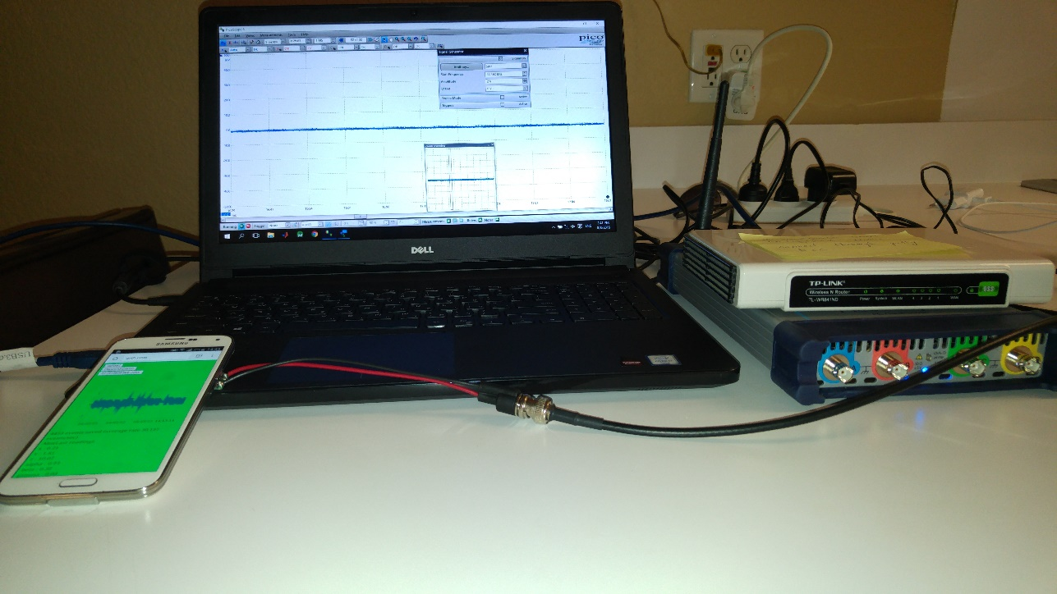
Poster Session on Thursday
Come and watch a live attack on Thursday at 18:30.

Slide 3
Outline
Introduction
Gyroscopes On Personal Devices
The Attack
Results
Countermeasures
Conclusions

Slide 4
Implant Architecture
Secret Collection – Microphone, camera, side-channel probe.
Secret Exfiltration – RF backscatter, acoustical coupling, this work.
Power Supply – Passive power, battery.

Slide 5
Outline
Introduction
Gyroscopes On Personal Devices
The Attack
Results
Countermeasures
Conclusions

Slide 6
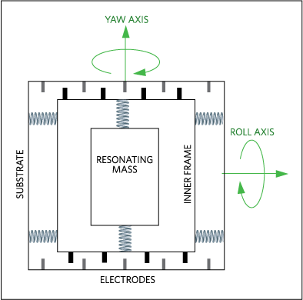
Gyroscopes On Personal Devices
MEMS gyroscopes sense the angular rate of rotation.
https://www.maximintegrated.com

Slide 7
Outline
Introduction
Gyroscopes On Personal Devices
The Attack
Results
Countermeasures
Conclusions

Slide 8
The Attack – Attack model
Base assumptions:
The adversary manages to place the implant near the victim’s mobile device.
The implant has some secret it wishes to exfiltrate.
The attacker has the ability to make the victim’s mobile device display a website or run some unprivileged application.

Slide 9
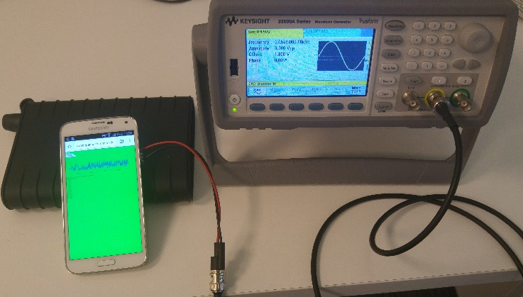
The Attack – Evaluation Setup

Slide 10
The Attack – PRBS example

Slide 11
The Attack – Advantages
Advantages of our exfiltration scheme over traditional methods:
Gyro access requires zero permissions or notifications
Sensitivity of the sensor

Slide 12
Outline
Introduction
Gyroscopes On Personal Devices
The Attack
Results
Countermeasures
Conclusions

Slide 13
Results – Error rate
Increasing amount of samples per data bit improve the results.
Audio signal can’t be heard by the human ear or detected as motion.
Consumes less than 10 microwatt of power.

Slide 14
Results – Activity profiles
Samsung S5 results tested on different user activities running a native application.

Slide 15
Results – Capacity and power bounds
Theoretical capacity of the channel is 1 Kbps with 60 Hz sampling rate.
Can grow over 4 Kbps when increasing the sampling rate.

Slide 16
Outline
Introduction
Gyroscopes On Personal Devices
The Attack
Results
Countermeasures
Conclusions

Slide 17
Countermeasures
Require permission to the gyroscope.
Lower the sampling rate.
Physical modification.
Sensor fusion.

Slide 18
Outline
Introduction
Gyroscopes On Personal Devices
The Attack
Results
Countermeasures
Conclusions

Slide 19
Conclusions
Low cost implants
No exposure risk
Undetectable bugs
Allow monitoring many implants simultaneously

Slide 20
Conclusions – Two factor authentication
https://www.comda.co.il

Slide 21
Questions?
Benyamin Farshteindiker
farshben@post.bgu.ac.il
https://iss.oy.ne.ro/PhoneHome
* Don’t forget to come to our poster session on Thursday.

